Slide 1
SCALA PROJECT
Hedge Fund Application: Real Time Risk Analysis
Team 2:
Shreya Nair
Amit Pingale
Mayank Gangrade Project GitHub Link

Slide 2
Goal
Building reactive application for portfolio management and risk analysis
Leveraging:
Kafka + Spark streaming
Spark Analysis engine
MongoDB for maintaining historic records + batch processing

Slide 3
Why Real-time Big Data Pipeline Important
It is estimated that by 2020 approximately 1.7 megabytes of data will be created every second. This results in an increasing demand for real-time and streaming data analysis. For historical data analysis descriptive, prescriptive, and predictive analysis techniques are used. On the other hand, for real-time data analysis, streaming data analysis is the choice. The main benefit of real-time analysis is one can analyze and visualize the report on a real-time basis.

Slide 4
Technology and Tools:
Alpha Vantage API for Real Time Data
Kafka for capturing Real Time Data
Spark Streaming For Consuming Data
Spark + Scala for performing Analysis on the data
Spark Machine Learning Library
MongoDb*
Tableau
Jupyter Notebook - Scala kernel
* Dumping historic and predicted data on NoSQL database like MongoDB

Slide 5
Analysis on Data
Data features: Stocks
Linear Regression
Decision Tree Regression
Random forest Regression
Gradient Boosting Regression
Open
High
Close
Adj Open
Volume
Low

Slide 6
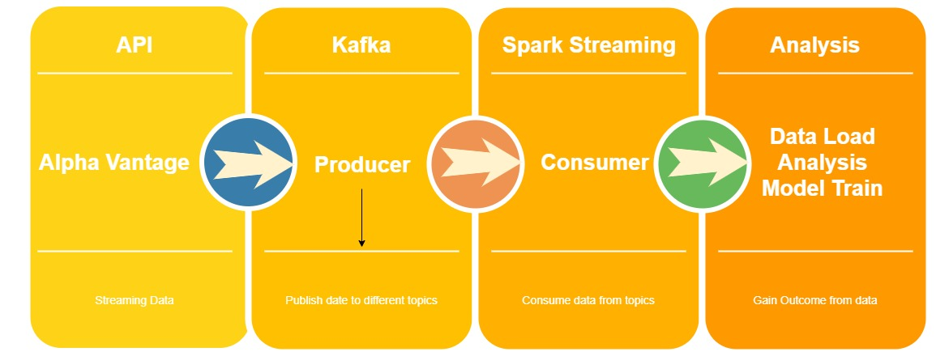
High Level Architecture

Slide 7

Acceptance criteria
Fetching stock/option data every 5 mins and Publishing the same on Kafka Topics
Consume the data from Kafka as soon as it arrived and store the same in to Database
Developing ensemble of 4 machine learning models
Selecting best model depending upon RMSE value (RMSE < 0.7)
Update data in real time interactive dashboards

Slide 8
Project subdivision:
Data Engineering
Machine Learning
Data Analytics

Slide 9
Data Engineering

Slide 10
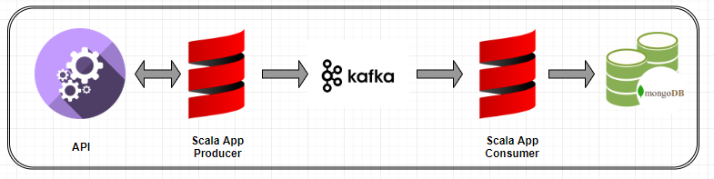
Data Engineering:

Slide 11
Machine Learning

Slide 12
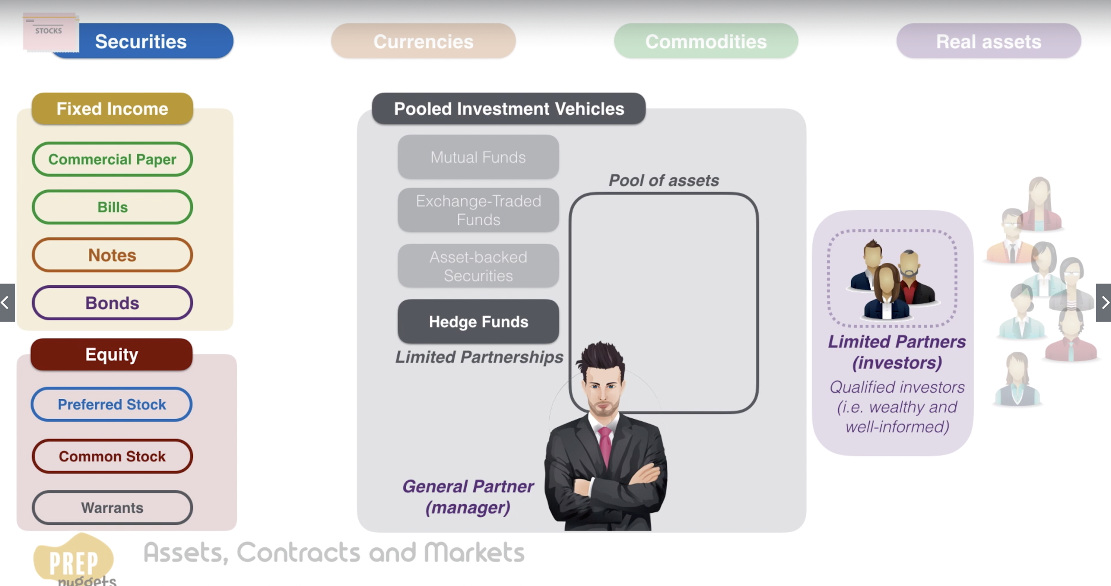
What is Hedge Fund?

Slide 13
Risk Management in Portfolio Construction
Methods Used in Hedge Fund Company:
Inverse correlation of the securities
Protected Put (Long Position on a Asset + Long Put Position on the same Option Market Asset)
Fiduciary Call (Long Call on the Options Market + Risk Free Bond)

Slide 14
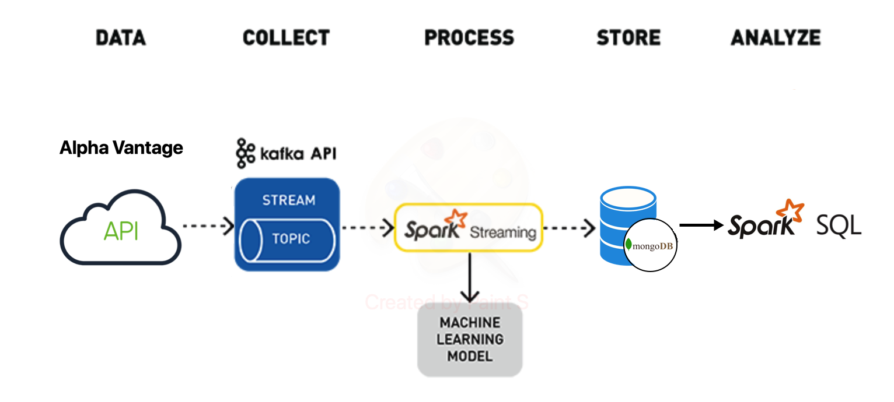
Architecture

Slide 15
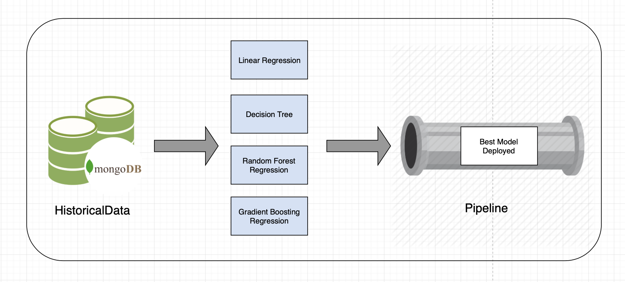
ML Pipeline Construction

Slide 16
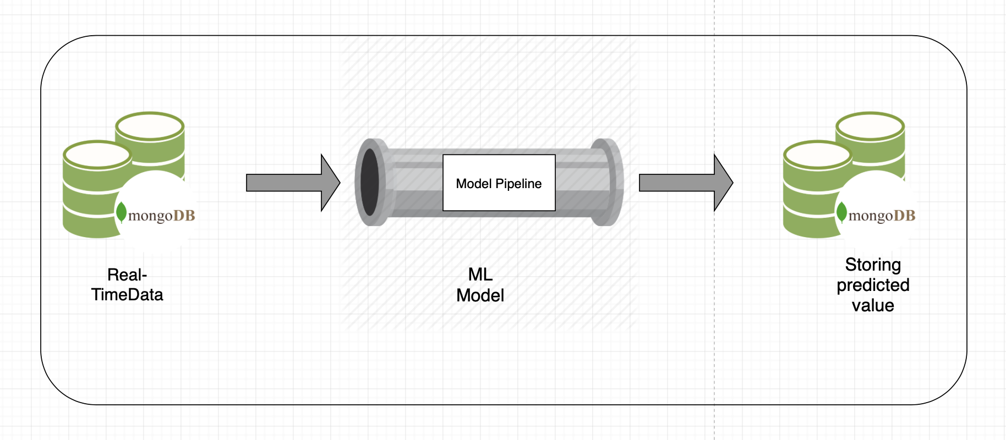
Real-Time Prediction

Slide 17
Trading Strategy
Assumption:
The market value of a security is corrupted by noise
High Frequency Trading
Market Sentiment
False Information
The model constructed is immune to these noises
Conclusion:
Real Value > Predicted Value ---> Security is overvalued ---> Sell/Short Position
Real Value < Predicted Value ---> Security is undervalued ---> Buy/Long Position
Real Value == Predicted Value ---> Security is properly valued ---> Hold Position

Slide 18
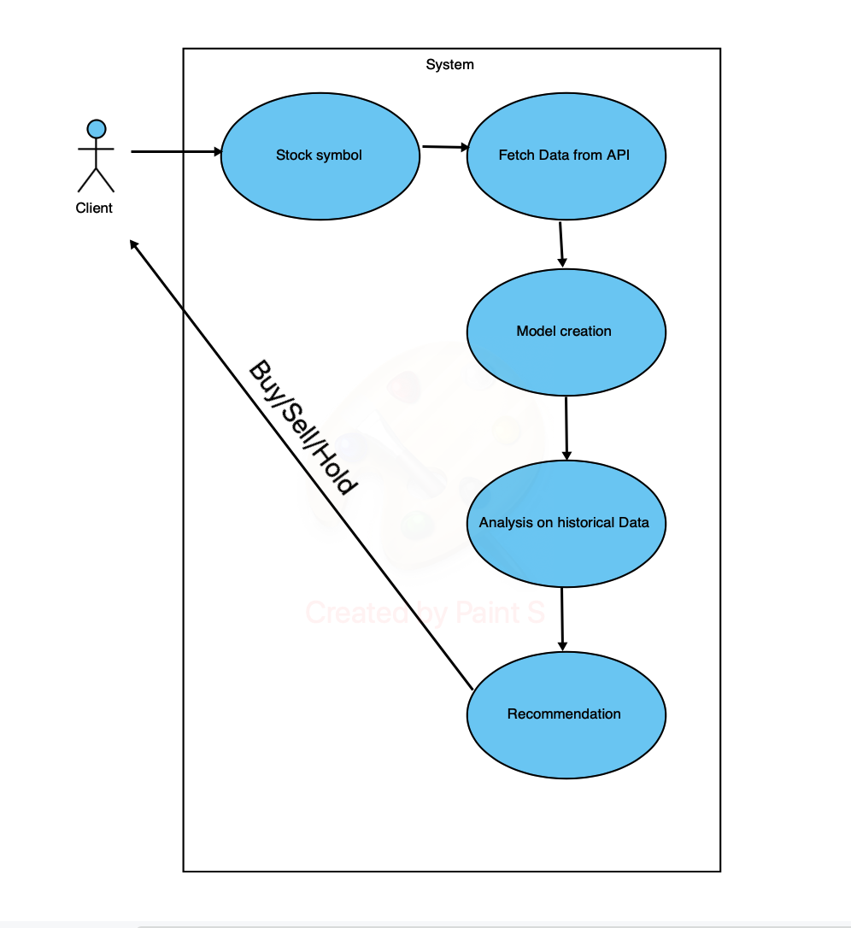
Use Case Diagram

Slide 19
Data Analysis

Slide 20
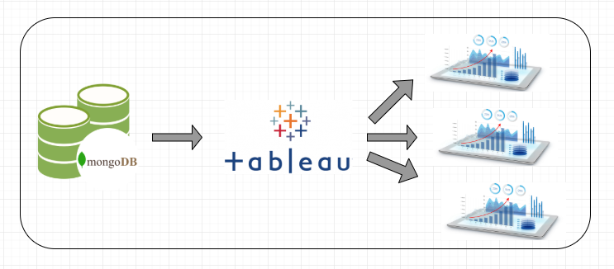
Data Analytics:

Slide 21
Data Analytics
Live data Streaming: Fetching Open stock price and Predicted stock price getting fed in MongoDB on real time basis
Connecting MongoDB with Tableau using BI Connector - Simba for Real Time data visualisation
In Tableau, presenting dynamic charts (changing with respect to Date-time) as per the data input
Showing Error ( Original - Predicated stock price) , to guide user, if to sell or purchase the stock
Showing how change in Open and Predicted Open stock affects the Volume of the stock

Slide 22
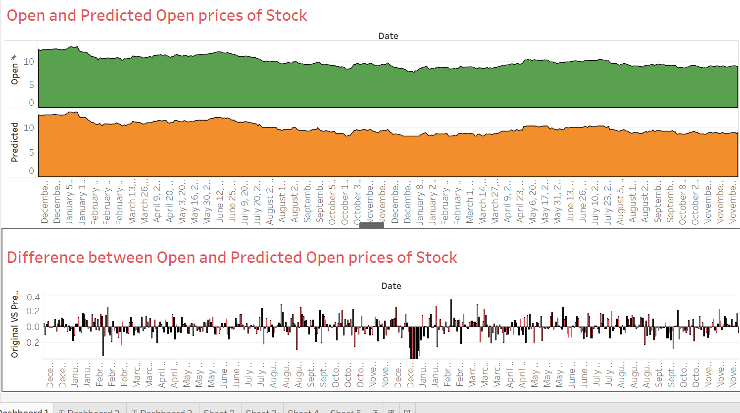
Data Analytics (a)

Slide 23
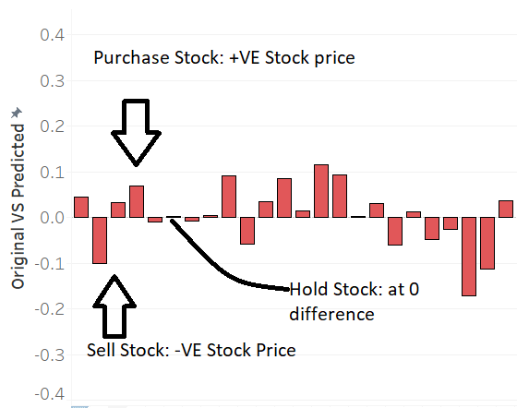
Data Analytics: When to sell, Purchase or Hold a stock

Slide 24
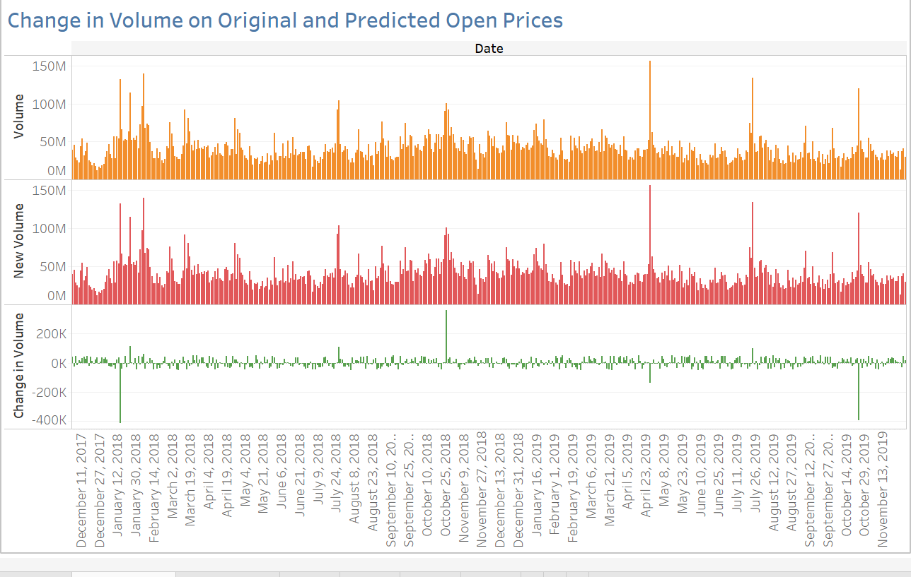
Data Analytics (b)

Slide 25
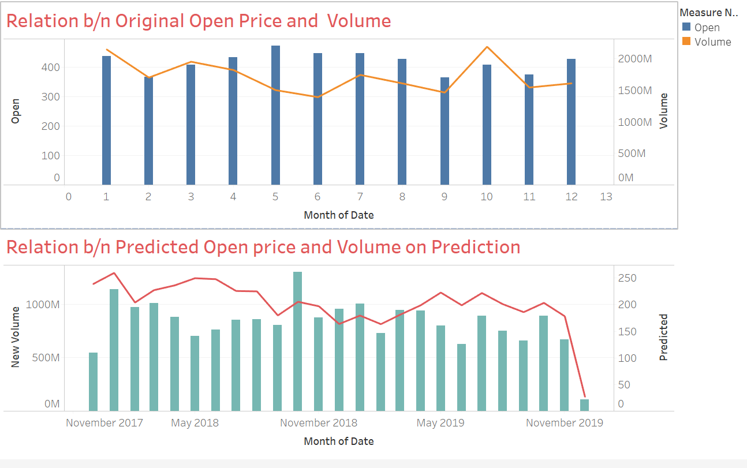
Data Analytics (c)

Slide 26
Thank You

